Slide 1
The `this` Pointer
Definition: this is a pointer to the object for which a member function is called.
  Therefore, inside a member function, this may be used to refer to the invoking object.
  “this” pointer holds the memory address of the object that is being called by a member function, allowing those functions to correctly access the object’s data members.
    Every object in C++ has access to its own address through this pointer.
Purpose: helps differentiate between member variables and parameters with the same name, and how it can be used to return the current object from a member function.
  It’s not necessary to explicitly define the “this” pointer as a function argument within the class, as the compiler handles it automatically.
  The `this` pointer is an implicit parameter to all member functions.
The 'this' pointer allows objects to refer to themselves and access their own member variables and member functions.
  It is especially useful when there's a need to distinguish between member variables and parameters with the same name.
    For example, in constructors and setter methods, it clarifies which variable is the member variable.
Points to the Object: this always points to the object that called the member function. This allows the function to access and modify the calling object's data members and other member functions.
Friend functions and non-member functions do not have a `this’ pointer, because they are not members of a class.
  Only member functions have a `this` pointer.

Slide 2
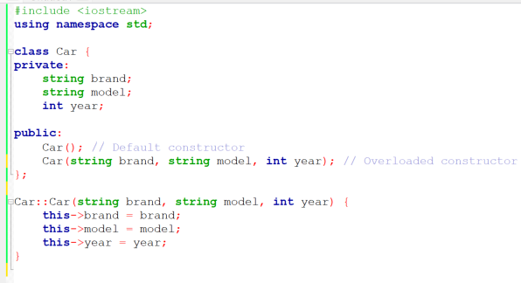
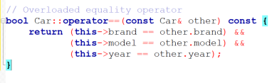
Using this Pointer in C++
When creating or using the 'this' pointer:
  the 'this' keyword in C++ is used in conjunction with the arrow operator (->) along with the name of the member or method being referred to
Here are some common uses in C++:
  Accessing data members: Inside a member function, you can use the “this” pointer to access the data members of the object that called the function.
    The `this` pointer is used to refer to the member variables brand, model, and year.
    This helps avoid any potential confusion
    the parameters brand, model, and year have the same names as the member variables.
      Using this->brand, this->model, and this->year ensures that we are assigning the parameter values to the member variables, not to the parameters themselves.
  Comparing objects: Inside a member function, you can use the “this” pointer to compare the object that called the function to another object.
    The overloaded equality operator compares the member variables of the current object (this) with those of another Car object (other).
    The `this` pointer is used to access the member variables of the current object.

Slide 3
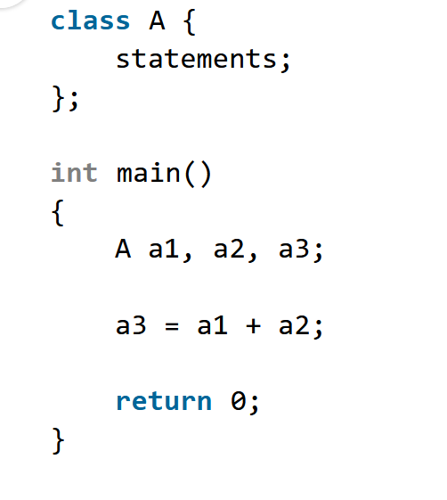
Introduction
Suppose we have 3 variables a1, a2, a3 of type “class A”
Adding two objects a1 and a2 which are user-defined type is not allowed.
  This is because the addition operator ‘+’ is predefined to
  operate only on built-in data types, i.e. int, float, double, etc
  In this case, class A is a user-defined type, so the compiler
  generates error
  This is where the concept of “Operator Overloading” comes in

Slide 4
Operator Overloading
If we want to make the operator ‘+’ add two class objects, we have to redefine the meaning of the ‘+’ such that it add two class objects
We achieve this by using the concept of “Operator overloading”
  Redefining the meaning of operators does not change their original meaning
    It simply extends their functionality.
  Overloaded operators are implemented as functions with special names: start with the keyword "operator" followed by the symbol for the operator being defined.
    E.g. `operator+` is the overloaded `+` operator (used to overload the addition operator (+))
  Box operator+(const Box& box);
    Declares the addition operator to add two Box objects and returns the final Box object

Slide 5
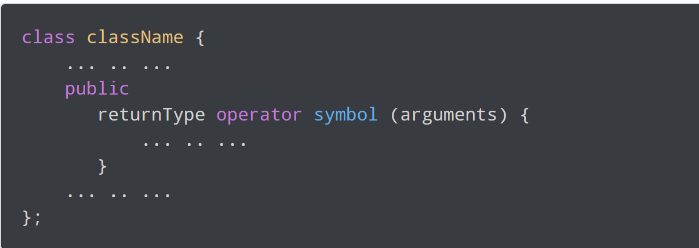
The syntax for C++ Operator Overloading
Here is the syntax:
  returnType is the return type of the function
  operator is a keyword
  symbol is the operator we want to overload
  like: +, <, -, ++, etc.
  arguments are the arguments passed to the
  function

Slide 6
Rules of operator overloading
You can only overload an operator as its type (unary cannot be overloaded as binary and vice versa).
  Unary Operators: These operators operate on only one operand. Examples include unary - (negation), ++ (increment), -- (decrement), etc.
  Binary Operators: These operators operate on two operands. Examples include binary + (addition), - (subtraction), * (multiplication), / (division), etc.
You can’t overload operators that are not a part of C++.
At least one operand must be a user-defined class object
You cannot change the operator’s existing functionality.
Unary operators overloaded as member functions take no explicit arguments.
  But when overloaded by a friend function or non-member function, they take one argument.
Binary operators overloaded as member functions take one explicit argument.
  If overloaded through a friend function or non-member function, they instead take two explicit arguments.

Slide 7
Ways of operator overloading
Operator overloading of member functions.
Operator overloading of non-member or friend functions.

Slide 8
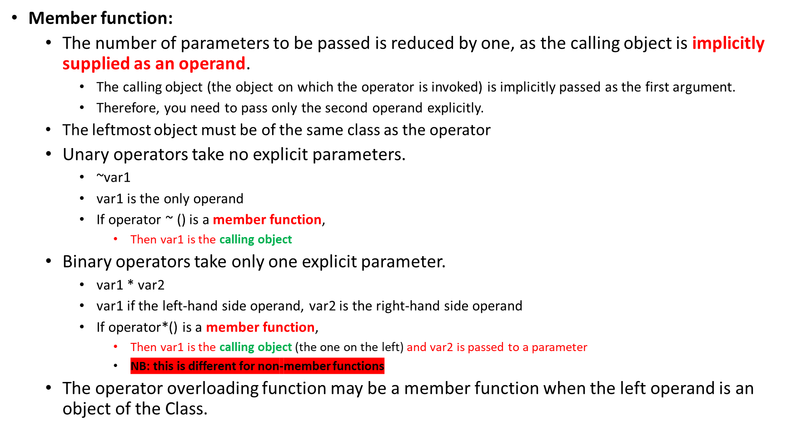
Difference between Member and friend function cont..

Slide 9
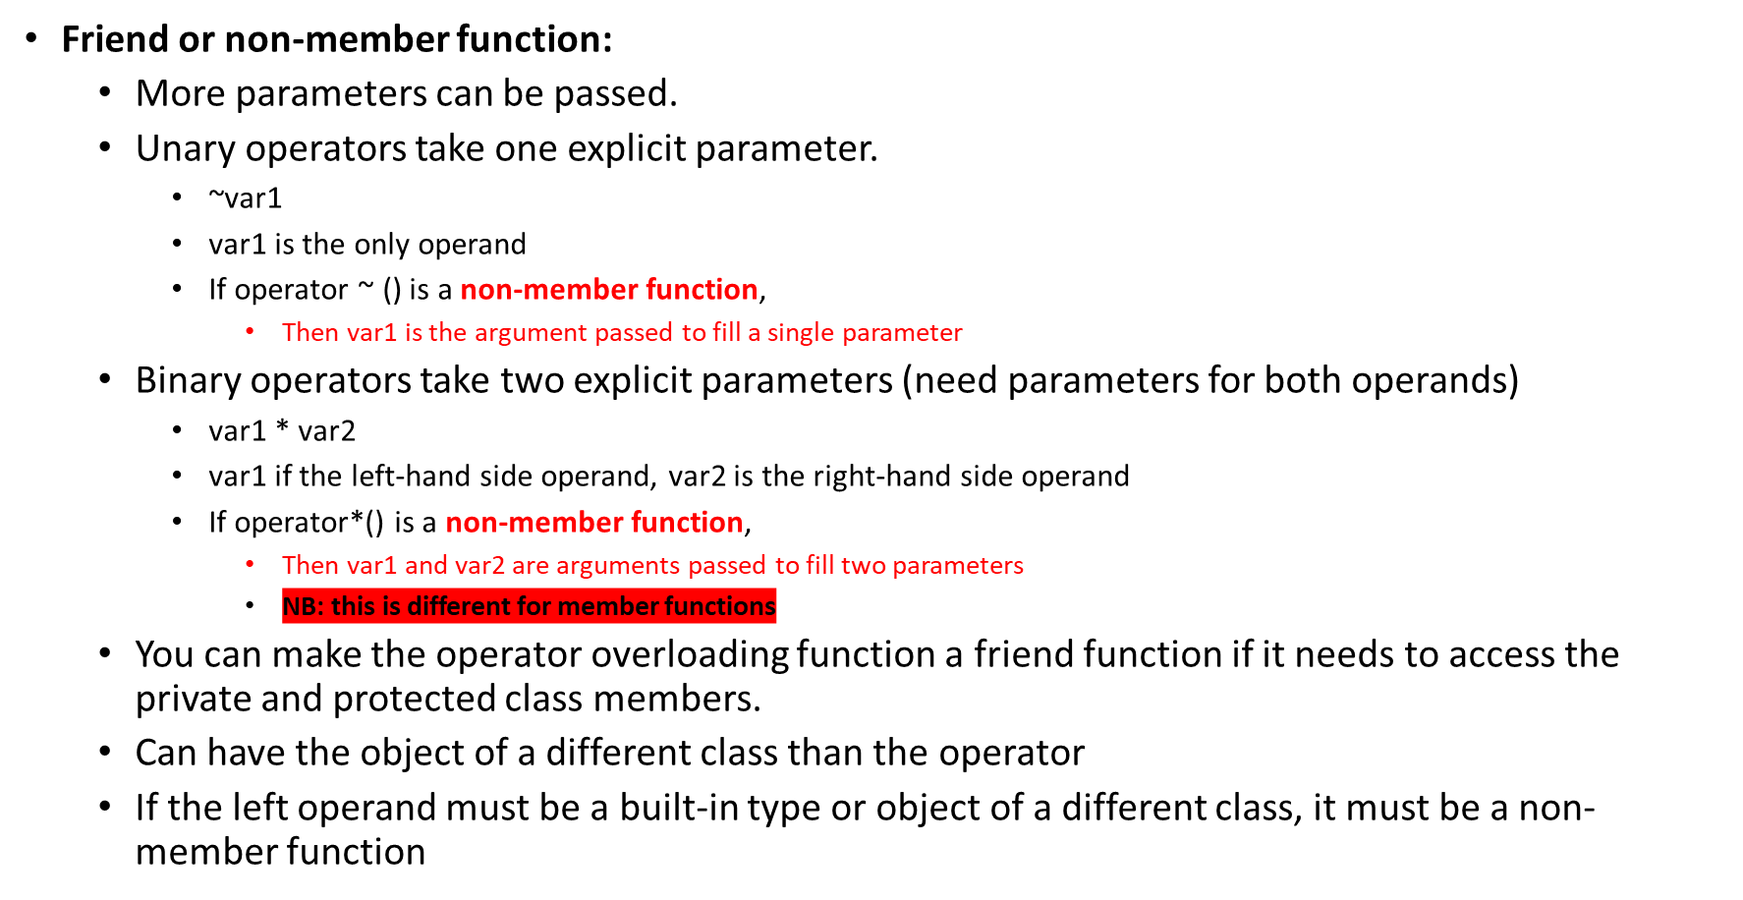
Difference between Member and friend function

Slide 10
Overloading Types of Operators
`++`, `--` operators overloaded differently for prefix vs. postfix notation
  Prefix notation
    Increment and decrement operators are placed before the operand (`++obj`, `--obj`)
    Overloaded increment/decrement operator returns the updated object after incrementing or decrementing
    It performs the operation first, then returns the modified object
  Postfix notation
    Increment and decrement operators are placed after the operand (`obj++`, `obj--`)
    Overloaded increment/decrement operator returns a copy of the original object before incrementing or decrementing
    It creates a temporary copy of the object, performs the operation on the original object, then returns the copy
11-<number>
Notes:
See Length1.h, Length1.cpp, pr11-11.cpp for the first three

Slide 11
Stream Insertion and Extraction Operators as Global Functions
Overloaded stream operators `>>`, `<<` must return `istream` and `ostream` objects, respectively.
  and take `istream`, `ostream` objects as parameters
  operator<< allows you to output the object to an ostream.
  operator>> allows you to input the object from an istream.
Overload `<<` operator used where
  Left operand of type `ostream&`
    Such as cout object in `cout << classObject`
Overload `>>` has left operand of `istream&`
  Left operand of type `istream&`
    Such as cin object in `cin >> classObject`

